Slide 1

Operating Systems Design​ Session 23: Traps and Interrupts
19CS2106R​
© 2020 KL University

Slide 2
Device Management

Slide 3
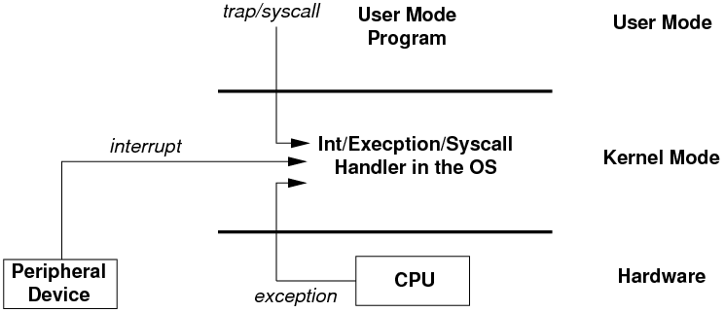
Interrupts/Trap
An interrupt is a way of talking to the operating system.
When a process requires some service from the operating system, it sends an interrupt.
(A system call)
An interrupt can be sent by hardware.
(An interrupt)
Whenever a user program produces an error, The CPU itself can also call an interrupt.
(An exception)

Slide 4
OS Plan for handling Interrupts
while(fetch next instruction)
An interrupts stops the normal processor loop and starts executing a new sequence called an interrupt handler.
Before starting the interrupt handler, the processor saves its registers, so that the operating system can restore them when it returns from the interrupt.
A challenge in the transition to and from the interrupt handler is that the processor should switch from user mode to kernel mode, and back.
Current task suspended
Execute Instruction
Where?
Execute event in handler
If event
yes
no

Slide 5
Operating System Design requirements
The system must save the processor’s registers for future transparent resume.
The system must be set up for execution in the kernel.
The system must chose a place for the kernel to start executing.
The kernel must be able to retrieve information about the event, e.g., system call arguments.
It must all be done securely; the system must maintain isolation of user processes and the kernel.

Slide 6
Interrupt Descriptor Table
Each interrupt/exception provided a number
Number used to index into an Interrupt descriptor table (IDT)
IDT provides the entry point into a interrupt/exception handler
0 to 255 vectors possible
0 to 31 used internally
Remaining can be defined by the OS
0 to 31 reserved by Intel
32 to 63 used for hardware interrupts
T_IRQ0 = 32 (added to all hardware IRQs toscale them)
64 used for system call interrupts

Slide 7
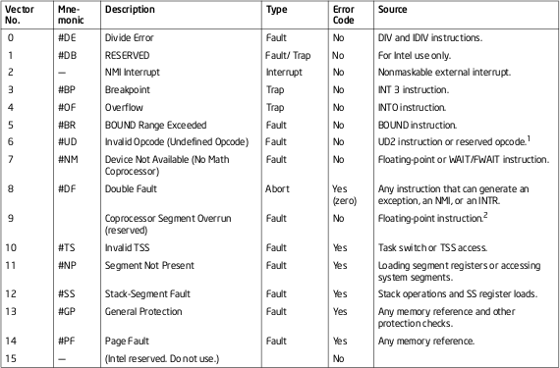

Slide 8
1
After current instruction completes
CPU senses interrupt line and obtains IRQ number from LAPIC
By CPU
2
Switch to kernel stack if necessary
3
X86 saves the SS, ESP, EFLAGS, CS, EIP, error code on stack (restored by iret instruction).
Suspends current task.
Basic program state saved
4
Jump to interrupt handler
How does hardware find the OS interrupt handler?
5
Just do the important stuff like
… respond to interrupt
… more storing of program state
… schedule the bottom half
… IRET
Restore flags and registers saved earlier. Restore running task.
software
Interrupt handler (top half)
6
Return from interrupt

Slide 9
3
2
Switch to kernel stack if necessary
Basic program state saved
only if stack changed
Switch to kernel stack if necessary
When event occurs OS executes
If executing user process, privilege changes from low to high If already in OS no privilege change
Saving Program State
Current program being executed must be able to resume after interrupt service is completed
By hardware
SS
ESP
EFLAGS
CS
EIP
Error Code
Trap Number
ds
es
…
eax
ecx
…
esi
edi
esp
(empty)
Pushed by hardware or software
By software
argument for trap
(pointer to this trapframe)
ESP
trapframe
p->kstack
Done automatically by CPU

Slide 10
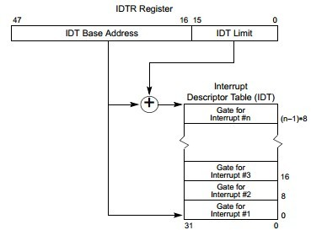
4
Jump to interrupt handler
IDT : Interrupt descriptor table
Also called Interrupt vectors
Stored in memory and pointed to by IDTR Conceptually similar to GDT and LDT Initialized by OS at boot
Done automatically by CPU

Slide 11
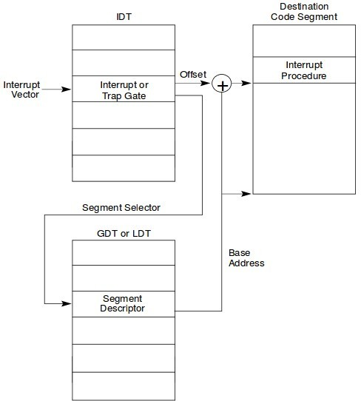
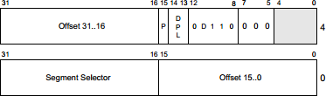
5
Interrupt handler
Each IDT has
Segment Selector : SEG_KCODE
This is the offset in the GDT for kernel code segment
Offset : (interrupt) vectors (generated by Script vectors.pl)
Memory addresses for interrupt handle
256 interrupt handlers possible
IDTR : pointer to IDT table in memory

Slide 12
XV6 Implementation

Slide 13
1217 main(void)
1218 {
1219 kinit1(end, P2V(4*1024*1024)); // phys page allocator
1220 kvmalloc(); // kernel page table
1221 mpinit(); // detect other processors
1222 lapicinit(); // interrupt controller
1223 seginit(); // segment descriptors
1224 picinit(); // disable pic
1225 ioapicinit(); // another interrupt controller
1226 consoleinit(); // console hardware
1227 uartinit(); // serial port
1228 pinit(); // process table
1229 tvinit(); // trap vectors
1230 binit(); // buffer cache
1231 fileinit(); // file table
1232 ideinit(); // disk
1233 startothers(); // start other processors
1234 kinit2(P2V(4*1024*1024), P2V(PHYSTOP));
1235 userinit(); // first user process
1236 mpmain(); // finish this processor’s setup
1237 }
Preparing for Traps
External interrupts are routed from peripherals to CPUs in multi processor systems through APIC (Advanced Programmable Interrupt Controller)
Comprises of two components
Local APIC (LAPIC)
I/O APIC
Plan 9 (entryother.S, mp.h, mp.c, lapic.c)
FreeBSD (ioapic.c)
traps.h – defines all the traps in xv6
Vectors.pl – generates vectors.S for allocating to all the interrupts.
trap.c - tvinit() for initializing traps to a vectors and making the entry in to IDT.

Slide 14
Handling Traps
Switchuvm:
The function switchuvm stores the address of the top of the kernel stack of the user process into the task segment descriptor.
On trap If the processor was executing in user mode, it loads %esp and %ss from the task segment descriptor, pushes the old user %ss and %esp onto the new stack.
Alltraps:
Alltraps continues to save processor registers: it pushes %ds, %es, %fs, %gs, and the general-purpose registers. The result of this effort is that the kernel stack now contains a struct trapframe
Trap:
Once the segments are set properly, alltraps can call the C trap handler trap.
Trapret:
After trap returns, alltraps pops the argument off the stack by adding to the stack pointer and then starts executing the code at label trapret

Slide 15
3200 // x86 trap and interrupt constants.
3201
3202 // Processor−defined:
3203 #define T_DIVIDE 0 // divide error
3204 #define T_DEBUG 1 // debug exception
3205 #define T_NMI 2 // non−maskable interrupt
3206 #define T_BRKPT 3 // breakpoint
3207 #define T_OFLOW 4 // overflow
3208 #define T_BOUND 5 // bounds check
3209 #define T_ILLOP 6 // illegal opcode
3210 #define T_DEVICE 7 // device not available
3211 #define T_DBLFLT 8 // double fault
3212 // #define T_COPROC 9 // reserved (not used since 486)
3213 #define T_TSS 10 // invalid task switch segment
3214 #define T_SEGNP 11 // segment not present
3215 #define T_STACK 12 // stack exception
3216 #define T_GPFLT 13 // general protection fault
3217 #define T_PGFLT 14 // page fault
3218 // #define T_RES 15 // reserved
3219 #define T_FPERR 16 // floating point error
3220 #define T_ALIGN 17 // aligment check
3221 #define T_MCHK 18 // machine check
3222 #define T_SIMDERR 19 // SIMD floating point error
xv6/traps.h
3224 // These are arbitrarily chosen, but with care not to overlap
3225 // processor defined exceptions or interrupt vectors.
3226 #define T_SYSCALL 64 // system call
3227 #define T_DEFAULT 500 // catchall
3228
3229 #define T_IRQ0 32 // IRQ 0 corresponds to int T_IRQ
3230
3231 #define IRQ_TIMER 0
3232 #define IRQ_KBD 1
3233 #define IRQ_COM1 4
3234 #define IRQ_IDE 14
3235 #define IRQ_ERROR 19
3236 #define IRQ_SPURIOUS 31

Slide 16
xv6/vectors.pl
3250 #!/usr/bin/perl −w
3251
3252 # Generate vectors.S, the trap/interrupt entry points.
3253 # There has to be one entry point per interrupt number
3254 # since otherwise there’s no way for trap() to discover
3255 # the interrupt number.
3256
3257 print "# generated by vectors.pl − do not edit\n";
3258 print "# handlers\n";
3259 print ".globl alltraps\n";
3260 for(my $i = 0; $i < 256; $i++){
3261 print ".globl vector$i\n";
3262 print "vector$i:\n";
3263 if(!($i == 8 || ($i >= 10 && $i <= 14) || $i == 17)){
3264 print " pushl \$0\n";
3265 }
3266 print " pushl \$$i\n";
3267 print " jmp alltraps\n";
3268 }
3269
3270 print "\n# vector table\n";
3271 print ".data\n";
3272 print ".globl vectors\n";
3273 print "vectors:\n";
3274 for(my $i = 0; $i < 256; $i++){
3275 print " .long vector$i\n";
3276 }
3277

Slide 17
xv6/trap.c - tvinit
3360 // Interrupt descriptor table (shared by all CPUs).
3361 struct gatedesc idt[256];
3362 extern uint vectors[]; // in vectors.S: array of 256 entry pointers
3363 struct spinlock tickslock;
3364 uint ticks;
3366 void
3367 tvinit(void)
3368 {
3369 int i;
3370
3371 for(i = 0; i < 256; i++)
3372 SETGATE(idt[i], 0, SEG_KCODE<<3, vectors[i], 0);
3373 SETGATE(idt[T_SYSCALL], 1, SEG_KCODE<<3, vectors[T_SYSCALL], DPL_USER);
3374
3375 initlock(&tickslock, "time");
3376 }
setgate(interrupt no, 0 (disable – nested interrupts), segment, offset, 0 (not from user mode)
This is for system call –
(systemcall, 1 (enable interrupt), segment, offset, DPL_User( can generate from user))

Slide 18
Handling Traps
Switchuvm:
The function switchuvm stores the address of the top of the kernel stack of the user process into the task segment descriptor.
On trap If the processor was executing in user mode, it loads %esp and %ss from the task segment descriptor, pushes the old user %ss and %esp onto the new stack.
Alltraps:
Alltraps continues to save processor registers: it pushes %ds, %es, %fs, %gs, and the general-purpose registers. The result of this effort is that the kernel stack now contains a struct trapframe
Trap:
Once the segments are set properly, alltraps can call the C trap handler trap.
Trapret:
After trap returns, alltraps pops the argument off the stack by adding to the stack pointer and then starts executing the code at label trapret

Slide 19
1858 // Switch TSS and h/w page table to correspond to process p.
1859 void
1860 switchuvm(struct proc *p)
1861 {
1862 if(p == 0)
1863 panic("switchuvm: no process");
1864 if(p−>kstack == 0)
1865 panic("switchuvm: no kstack");
1866 if(p−>pgdir == 0)
1867 panic("switchuvm: no pgdir");
1868
1869 pushcli();
1870 mycpu()−>gdt[SEG_TSS] = SEG16(STS_T32A, &mycpu()−>ts,
1871 sizeof(mycpu()−>ts)−1, 0);
1872 mycpu()−>gdt[SEG_TSS].s = 0;
1873 mycpu()−>ts.ss0 = SEG_KDATA << 3;
1874 mycpu()−>ts.esp0 = (uint)p−>kstack + KSTACKSIZE;
1875 // setting IOPL=0 in eflags *and* iomb beyond the tss segment limit
1876 // forbids I/O instructions (e.g., inb and outb) from user space
1877 mycpu()−>ts.iomb = (ushort) 0xFFFF;
1878 ltr(SEG_TSS << 3);
1879 lcr3(V2P(p−>pgdir)); // switch to process’s address space
1880 popcli();
1881 }
Switchuvm in vm.c
Prepares kernel-stack of process
switchuvm also sets up a task
state segment SEG_TSS that instructs the hardware to execute system calls and interrupts on the process’s kernel stack.
set up %tr register and SEG_TSS section in GDT referring to top of process's kernel stack
Makes %tr register indirectly point to it
loads process's Page Table to %cr3.

Slide 20
xv6/trapasm.S
3300 #include "mmu.h"
3301
3302 # vectors.S sends all traps here.
3303 .globl alltraps
3304 alltraps:
3305 # Build trap frame.
3306 pushl %ds
3307 pushl %es
3308 pushl %fs
3309 pushl %gs
3310 pushal
3311
3312 # Set up data segments.
3313 movw $(SEG_KDATA<<3), %ax
3314 movw %ax, %ds
3315 movw %ax, %es
3316
3317 # Call trap(tf), where tf=%esp
3318 pushl %esp
3319 call trap
3320 addl $4, %esp
SS | Trapframe
ESP
EFLAGS
CS
EIP
Error Code
Trap Number
ds
es
…
eax
ecx
…
esi
edi
esp
(empty)
Catches and prepares all interrupts for trap.
Pushes register data on stack
store registers and build trapframe
set up data and per-CPU segments
call trap, using stack as argument
skip over top of frame (%esp address) without popping it into anything

Slide 21
Trap.c
3400 void
3401 trap(struct trapframe *tf)
3402 {
3403 if(tf−>trapno == T_SYSCALL){
3404 if(myproc()−>killed)
3405 exit();
3406 myproc()−>tf = tf;
3407 syscall();
3408 if(myproc()−>killed)
3409 exit();
3410 return;
3411 }
It will call the syscall() – if the interrupt is for System Call.
The kernel will execute syscall() and return back to this function
save tf to proc->tf, so that we don't need to start passing it around during syscall

Slide 22
Hardware Traps
Trap.c
3413 switch(tf−>trapno){
3414 case T_IRQ0 + IRQ_TIMER:
3415 if(cpuid() == 0){
3416 acquire(&tickslock);
3417 ticks++;
3418 wakeup(&ticks);
3419 release(&tickslock);
3420 }
3421 lapiceoi();
3422 break;
3423 case T_IRQ0 + IRQ_IDE:
3424 ideintr();
3425 lapiceoi();
3426 break;
3427 case T_IRQ0 + IRQ_IDE+1:
3428 // Bochs generates spurious IDE1 interrupts.
3429 break;
3430 case T_IRQ0 + IRQ_KBD:
3431 kbdintr();
3432 lapiceoi();
3433 break;
Timer trap – which will be generated for time sharing systems
when it's called for a time interrupt, does just two things: increment the ticks variable, and call wakeup. At the end of trap, xv6 calls yield.
May cause the interrupt to return in a different process!
IDE Trap – calls ideintr() – Will see in next session
Keyboard trap

Slide 23
3434 case T_IRQ0 + IRQ_COM1:
3435 uartintr();
3436 lapiceoi();
3437 break;
3438 case T_IRQ0 + 7:
3439 case T_IRQ0 + IRQ_SPURIOUS:
3440 cprintf("cpu%d: spurious interrupt at %x:%x\n",
3441 cpuid(), tf−>cs, tf−>eip);
3442 lapiceoi();
3443 break;
3450 default:
3451 if(myproc() == 0 || (tf−>cs&3) == 0){
3452 // In kernel, it must be our mistake.
3453 cprintf("unexpected trap %d from cpu %d eip %x (cr2=0x%x)\n",
3454 tf−>trapno, cpuid(), tf−>eip, rcr2());
3455 panic("trap");
3456 }
3457 // In user space, assume process misbehaved.
3458 cprintf("pid %d %s: trap %d err %d on cpu %d "
3459 "eip 0x%x addr 0x%x−−kill proc\n",
3460 myproc()−>pid, myproc()−>name, tf−>trapno,
3461 tf−>err, cpuid(), tf−>eip, rcr2());
3462 myproc()−>killed = 1;
3463 }
Trap.c
COM Port trap
A spurious interrupt is an invalid, short-duration signal on an interrupt input
If Problem with kernel
User process misbehave – Kill the process

Slide 24
Trap.c
3465 // Force process exit if it has been killed and is in user space.
3466 // (If it is still executing in the kernel, let it keep running
3467 // until it gets to the regular system call return.)
3468 if(myproc() && myproc()−>killed && (tf−>cs&3) == DPL_USER)
3469 exit();
3470
3471 // Force process to give up CPU on clock tick.
3472 // If interrupts were on while locks held, would need to check nlock.
3473 if(myproc() && myproc()−>state == RUNNING &&
3474 tf−>trapno == T_IRQ0+IRQ_TIMER)
3475 yield();
3476
3477 // Check if the process has been killed since we yielded
3478 if(myproc() && myproc()−>killed && (tf−>cs&3) == DPL_USER)
3479 exit();
3480 }
if process is user-process, and killed, and is not in the middle of a system-call, exit (and don't return to alltraps)
if process is running, and we had a timer-interrupt, and the process ran for long enough already, yield CPU back to scheduler
Gives up the CPU from a running process.
after previous yield, if process was killed (and not in middle of system-call), exit

Slide 25
xv6/trapasm.S
SS | Trapframe
ESP
EFLAGS
CS
EIP
Error Code
Trap Number
ds
es
…
eax
ecx
…
esi
edi
esp
(empty)
3321
3322 # Return falls through to trapret...
3323 .globl trapret
3324 trapret:
3325 popal
3326 popl %gs
3327 popl %fs
3328 popl %es
3329 popl %ds
3330 addl $0x8, %esp # trapno and errcode
3331 iret
pop registers and call iret
An operating system can use the iret instruction to return from an int instruction. It pops the saved values during the int instruction from the stack, and resumes
execution at the saved %eip.

